Slide 1
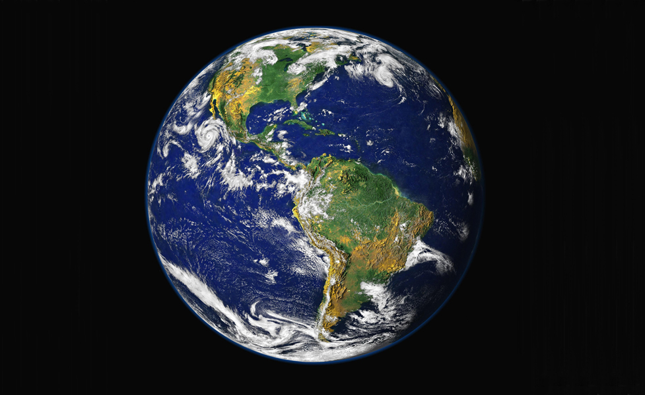
Chapter 1
General Biology I
BSC 2010
The Study of Life
credit: NASA/GSFC/NOAA/USGS

Slide 2
Timeline of Life on Earth
(Approximate)
credit: NASA/GSFC/NOAA/USGS
Billions of years ago: microorganisms in the ocean
~3.5 billion – bacteria; ~2.5 – unicellular eukaryotes
180-200 million years ago: animals and plants familiar to us
2.5 million years ago: humans (genus “Homo”)
200,000 years ago: modern-looking humans (“Homo sapiens”)

Slide 3
The Scope of Biology is Vast
Biology is the study of living organisms and their interactions with one another and their environments.
Biology is interdisciplinary - it intersects with other natural sciences, such as geology, physics, and chemistry, and with computer science, logic, and math.

Slide 4
Inductive and Deductive Reasoning
With inductive reasoning, related specific observations are used to arrive at a general conclusion.
With deductive reasoning, a general principle or law is used to forecast specific results.

Slide 5
Science uses both deductive and inductive reasoning
Inductive reasoning uses specific observations to develop general conclusions
If poodles have hair and terriers have hair, then you might generalize that all dogs have hair
Common in descriptive science
Deductive reasoning uses general principles to make specific predictions
If all mammals have hair and you find an animal that doesn’t, you might say that the animal you are looking at is not a mammal
Used to test the validity of general ideas in all branches of knowledge

Slide 6
Science can be Descriptive and/or Hypothesis-Based
I’ve discovered a new species!
Descriptive Science is usually inductive. It involves observation, exploration, and describing.
Hypothesis-based Science is usually deductive. It begins with a well-defined idea that can be tested experimentally.
I determined the cause of a disease!
Scientists often combine both of these approaches.

Slide 7
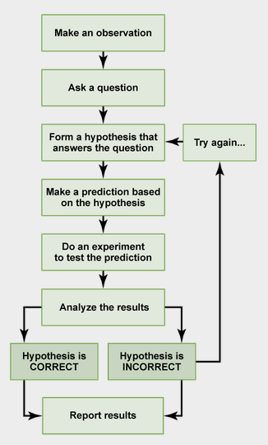
The Scientific Method
A hypothesis:
is a statement (not a question)
must be “falsifiable” (open to being disproved)
is more than an educated guess
Download for free at http://cnx.org/content/col11448/latest/

Slide 8
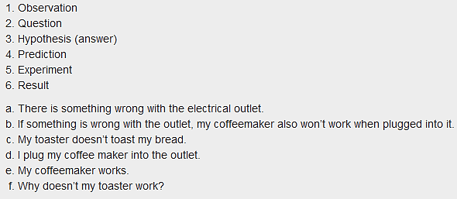
Put the steps in order.
Do the results support the hypothesis?
Download for free at http://cnx.org/content/col11448/latest/

Slide 9
What is a Scientific “Theory”?
A scientific theory is not a wild guess.
A theory is a tested and confirmed explanation for observations or phenomena.
A hypothesis may eventually become a verified theory.

Slide 10
Scientific theory
Is a body of interconnected concepts
Is supported by much experimental evidence and scientific reasoning
Expresses ideas of which we are most certain
When you say “theory” in biology, it is as close to LAW that you will get to with the information and technology we have available to us at the time
Compare to general meaning of theory
Different in everyday language, implies a lack of knowledge or a guess

Slide 11
An Experiment Tests a Hypothesis
An experiment is designed to try to refute a hypothesis by testing a variable.
An experimental set is compared to a control set.
The control set is the same as the experimental set in every way- except for the variable being tested.
When there is only one variable being tested, any difference between the sets must be due to that variable.
The exception is when there are additional “uncontrolled variables”. In this case, the results cannot be attributed to the hypothesized variable.

Slide 12
Basic Versus Applied Science
Basic science seeks to expand knowledge regardless of the short-term application of that knowledge.
The immediate goal of basic science is knowledge for knowledge’s sake.
It may ultimately result in a practical “applied” application.
Applied science aims to use science to solve real-world problems.
In applied science, the problem is usually defined for the researcher.

Slide 13
Peer-Reviewed Literature
Research Results
Papers detailing scientific methods and results are submitted to scientific journals for peer review.
Research reports usually follow the IMRaD* format. (*introduction, materials and methods, results, and discussion)
Qualified colleagues judge whether or not the work is original, significant, logical, thorough and worthy of publication.
Using the work or ideas of others without proper permission and citation is considered plagiarism.
So-called “review” articles do not follow the IMRaD format because they do not present original scientific findings or primary literature; instead, they summarize and comment on findings that were published as primary literature and typically include extensive reference sections.
These are PRIMARY RESOURCES – where you want to get the information

Slide 14
Primary Resources
Examples of scientific journals that are primary resources:
Nature
Journal of Molecular Biology
Journal of Immunology
Journal of Ecology
Journal of Virology
Journal of Experimental Medicine

Slide 15
SECONDARY RESOURCES
Magazine articles, internet, books, news reports, newspapers
Many of these do have the correct information
However, anyone can publish anything in these formats
Therefore, caution must be taken when reading the information
The author may not mean to be misleading – they themselves might have misread or misinterpreted the information in Primary Sources
New flash – news reporters and celebrities are not scientists!

Slide 16
Evaluating Scientific Information
Understanding Science from Secondary Sources
Use your understanding of the process of science to evaluate science stories.
News media generally highlight only those science stories that seem newsworthy.
They are more likely to report a positive result than a negative one.

Slide 17
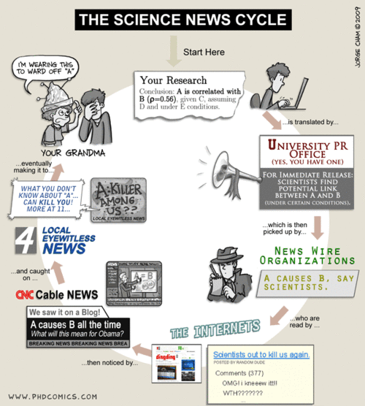

Slide 18
Ripped from the Headlines!
that certain brand of provocatively-headlined-but-probably-not-what-you-think-it-is science news that we know and love hate
“Mice can Inherit Memories”
“Men and women’s brains are wired differently, therefore men are better at reading maps

Slide 19
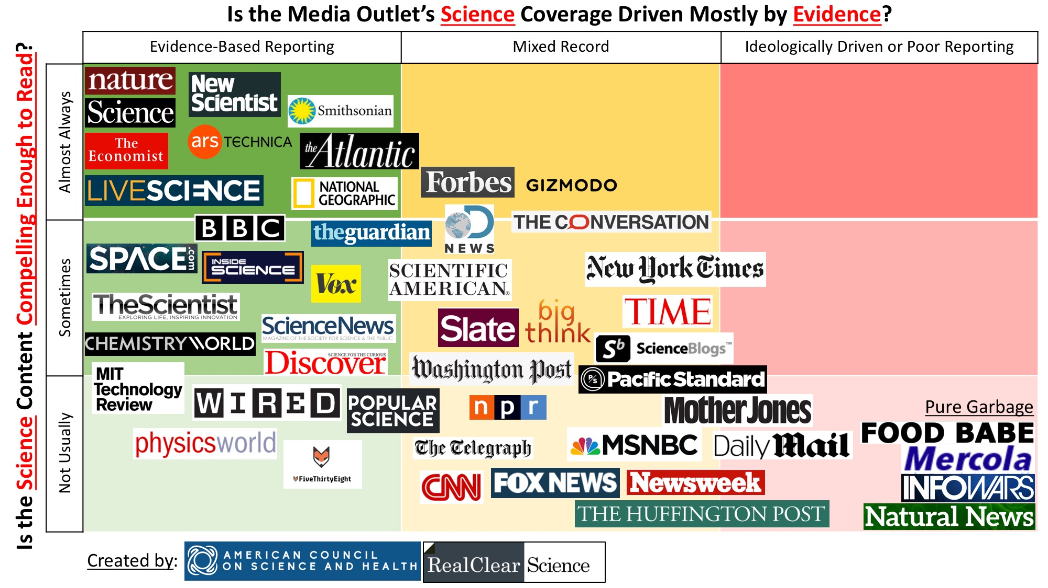

Slide 20
Properties of Life
Order – biological components are organized
Sensitivity/Response to Stimuli – movement
Reproduction – passing DNA down to offspring
Growth and Development – follow instructions coded by genes
Regulation – coordinate internal functions
Homeostasis – maintain constant internal conditions
Energy Processing – use sun or chemical energy
Life: defines as an organism made of one or more cell that can follow the functions listed above.

Slide 21
Hierarchy of Life
Caption: The simplest unit of life is the atom, like oxygen.
Two or more atoms is a molecule, like dioxide. Many molecules
is a macromolecule, such as a phospholipid. Multiple macromolecules
form a cell, like a Clara cell. A group of cells functioning together is a
tissue, for example, Epithelial tissue. Different tissues make up an
organ, like a lung. Organs work together to form an organ system,
such as the Respiratory System. All of the organ systems make a living
organism, like a lion. A group of the same organism living together in
an area is a population, such as a pride of lions. Two or more
populations interacting with each other form a community, for example,
lion and zebra populations interacting with each other. Communities
interacting not only with each other but also with the physical environment
encompass an ecosystem, such as the Savanna ecosystem. All of the
ecosystems make up the biosphere, the area of life on Earth.
(c)Mikala14, Public domain

Slide 22
The Science of Life
Living systems show hierarchical organization
Cellular level
Atoms, molecules, organelles, cells
Cell is the basic unit of life
Organismal level
Tissues, organs, organ systems
Populational level
Population, community
Ecosystem level
Biosphere
Earth is an ecosystem we call the biosphere
22

Slide 23
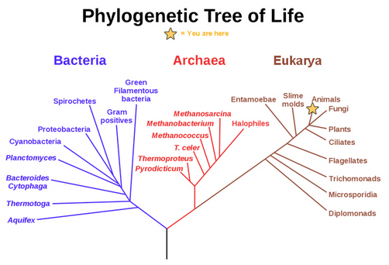
A Phylogenetic Tree Shows Evolutionary Relationships
The 3 Domains
Common Ancestor
Carl Woese in 1970s developed this tree based on rRNA sequence data
Download for free at http://cnx.org/contents/185cbf87-c72e-48f5-b51e-f14f21b5eabd@10.61

Slide 24
Prokaryotes versus Eukaryotes
Nucleolus
Caption: Celltypes (c)Snek01, Public domain
Caption: This is a phase contrast image of a cheek cell (c)Spencer Diamond, Public domain
Caption: Bacillus anthracis (c)Bruce Blaus, Public domain

Slide 25
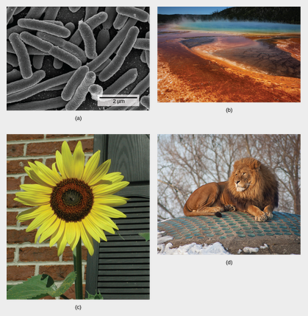
Three Domains
Domain:
Bacteria
Domain:
Archaea
Domain:
Eukarya
(Kingdom: Plants)
Domain:
Eukarya
(Kingdom: Animals)
Download for free at http://cnx.org/contents/185cbf87-c72e-48f5-b51e-f14f21b5eabd@10.61

Slide 26
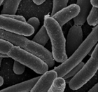
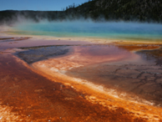
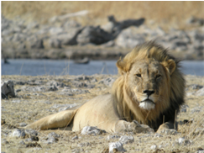
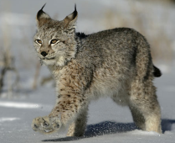
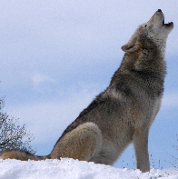
Phylogeny
Domain | Bacteria | Archae | Eukarya | Eukarya | Eukarya | Eukarya
Kingdom | Bacteria | Archaebacteria | Plantae | Animalia | Animalia | Animalia
Phylum | Proteobacteria | Archaeota | Anthophyta | Chordata | Chordata | Cordata
Class | Gammaproteobacteria | Thermococci | Eudicotyledones | Mammalia | Mammalia | Mammalia
Order | Enterobacter | Thermococcales | Asterales | Carnivora | Carnivora | Carnivora
Family | Enterobacteriaceae | Thermococcaceae | Asteraceae | Panthera | Felidae | Canidae
Genus | Escherichia | Thermococcus | Cynara | Panthera | Lynx | Canis
Species | Escherichia coli | T. profundus | C. scolymus | P. leo | L. canadensis | C. lupus
3
3 Domains
6 Kingdoms (Eubacteria, Archaea, Protista, Plantae, Animalia, and Fungi)

Slide 27
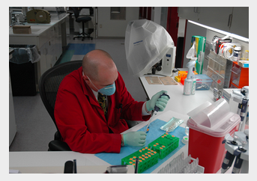
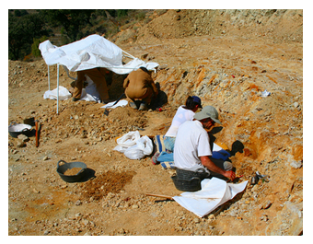
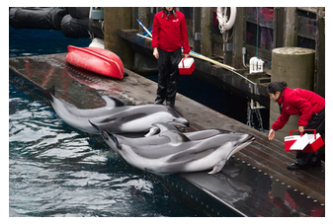
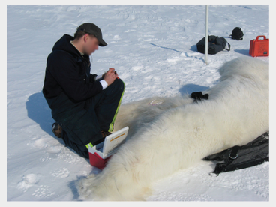
Branches of Biological Study
Molecular Biology
Biochemistry
Microbiology
Zoology
Botany
Biophysics
Neurobiology
Paleontology
… and many more
Download for free at http://cnx.org/contents/185cbf87-c72e-48f5-b51e-f14f21b5eabd@10.61

